Slide 1



台大管院訂閱之
產業研究智庫介紹
by Gartner
Senior Area Manager
Maggie Lee
CONFIDENTIAL AND PROPRIETARY
This presentation, including any supporting materials, is owned by Gartner, Inc. and/or its affiliates and is for the sole use of the intended Gartner audience or other intended recipients. This presentation may contain information that
is confidential, proprietary or otherwise legally protected, and it may not be further copied, distributed or publicly displayed without the express written permission of Gartner, Inc. or its affiliates. © 2018 Gartner, Inc. and/or its affiliates. All rights reserved.

Slide 2


1. Gartner 公司與服務介紹
2. 如何運用Gartner成為您的智囊團
3. 如何從臺大管院登入Gartner
議程

Slide 3
Gartner
公司與服務介紹
CONFIDENTIAL AND PROPRIETARY
This presentation, including any supporting materials, is owned by Gartner, Inc. and/or its affiliates and is for the sole use of the intended Gartner audience or other intended recipients. This presentation may contain information that
is confidential, proprietary or otherwise legally protected, and it may not be further copied, distributed or publicly displayed without the express written permission of Gartner, Inc. or its affiliates. © 2018 Gartner, Inc. and/or its affiliates. All rights reserved.

Slide 4
Who we are
Who We Are:
Gartner is the world’s leading information technology
research and advisory company.
We deliver the technology-related insight necessary
for our clients to make the right decisions, every day.
Gartner (顧能公司)國際研究暨資訊科技諮詢機構，成立於1979年。研究範圍涵蓋全部資訊科技產業，就資訊科技的研究、發展、評估、應用、市場等領域，為客戶提供客觀與公正的論證報告及諮詢服務。
Gartner資料庫是許多企業決策時的重要資訊，運用 Gartner在各國、各領域專業的分析師，能提供最新的趨勢和商業動態，協助企業將市場看得更清楚、判斷情境分析更透徹，用以降低投資風險、提高市場競爭力。
Notes:
Placeholder for text (substitute your own text; delete when not used)

Slide 5


Who we serve
Gartner 服務對象
IT End-User Professionals
High-Tech
& Telecom Professionals
CIOs, CTOs, CFOs, senior
IT executives and their
teams/associates
Executives, product leaders
and marketing/sales professionals in high-tech and telecom companies,
and their teams/associates
Supply Chain Professionals
Investment
Professionals
Heads of supply chain, senior supply chain executives and
functional teams
Buy-side investment professionals, including those in public equity,
venture capital, private equity and investment banking
Marketing Professionals
Digital marketing professionals, CMOs, chief customer officers, chief marketing technologists, heads of multichannel marketing, marketing analytics, digital commerce and their teams/associates
Notes:
EUP | 02.06.12
Placeholder for text (substitute your own text; delete when not used)

Slide 6





















Gartner 服務項目
Insights for
Your Role
CIO Program
Banking & Investment
Energy &
Utilities
Manufacture
Government
Industry Insight
Insurance Education
Media
Retail
Healthcare
Enterprise IT
IT Associates
IT Leaders
IT
Role-Based
IT
Execution
Technical Professionals
Technical Planner
Core Research
Insights of IT Topics

Slide 7
如何運用Gartner
成為您的智囊團
CONFIDENTIAL AND PROPRIETARY
This presentation, including any supporting materials, is owned by Gartner, Inc. and/or its affiliates and is for the sole use of the intended Gartner audience or other intended recipients. This presentation may contain information that
is confidential, proprietary or otherwise legally protected, and it may not be further copied, distributed or publicly displayed without the express written permission of Gartner, Inc. or its affiliates. © 2018 Gartner, Inc. and/or its affiliates. All rights reserved.

Slide 8
Gartner Core IT Research
Core IT Research for Higher Education Institutions covers a broad set of cross-industry technology topics and helps clients expand knowledge, build competencies, obtain objective viewpoints, and validate decisions to drive business value through technology.

Slide 9



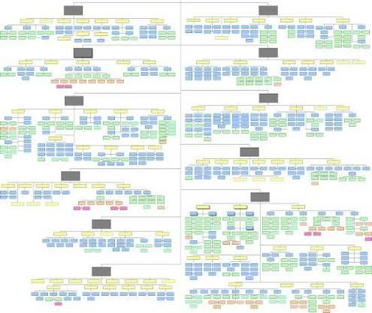









Gartner Core IT Research
Gartner IT Knowledge Map
Hard
ware
Commu
nications
Full Range of Business and Technology Topics
IT Mana and S
gement ervices
Soft
ware
Business, Technology and Society
Application Development
Application Integration & Middleware
Business Intelligence
Business Process Management
Consumer Technologies
Customer Relationship Management
Data Management & Integration
Emerging Trends & Technologies
Enterprise Architecture
ERP & Supply Chain Management
High-Performance Workplace
IT Asset Management
IT Operations
IT Management
IT Services
Mobile & Wireless
Networking & Communications Equipment
Networking & Communications Services
Open Source
Multisourcing
PCs, Laptops & Handheld Devices
Regulatory Compliance
Security & Privacy
Servers & Storage
Web Services

Slide 10






Gartner Core IT Research (Full Campus Level Access <4,999)
Strategic Planning Assumptions
provide management direction
around IT investments.
Hype Cycles
help you time your decisions about emerging technologies.
The Enterprise Personality Profile
clarifies how enterprise personality traits and behaviors shape choice, project investments and success.
®
Total Cost of Ownership (TCO ) provides a quantitative means to understanding the qualitative performance of the IT organization.
Magic Quadrants and MarketScopes
show you where markets are headed.
Vendor Ratings
help you manage product portfolio.
First Take
provide timely analysis of the industry events.
Case Examples
summarize real client experiences.

Slide 11
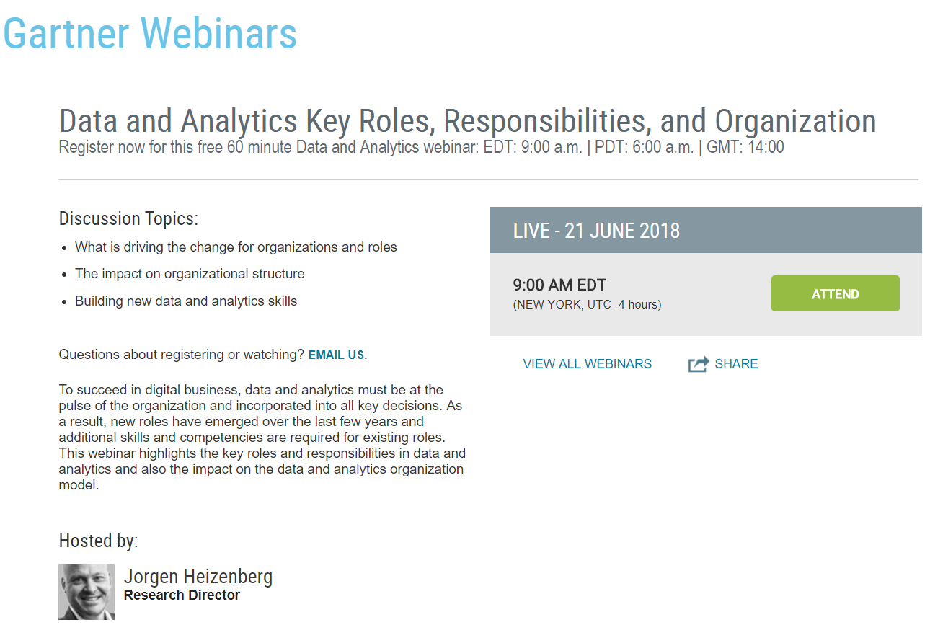
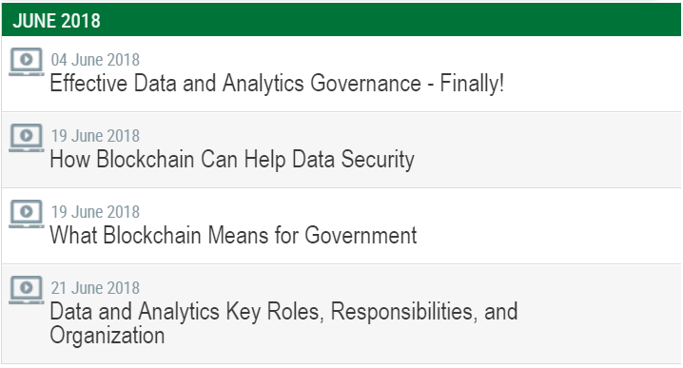
Gartner Core IT Research (Monthly On-Demand Webinars)

Slide 12
如何從臺大管院 登入Gartner服務
CONFIDENTIAL AND PROPRIETARY
This presentation, including any supporting materials, is owned by Gartner, Inc. and/or its affiliates and is for the sole use of the intended Gartner audience or other intended recipients. This presentation may contain information that
is confidential, proprietary or otherwise legally protected, and it may not be further copied, distributed or publicly displayed without the express written permission of Gartner, Inc. or its affiliates. © 2018 Gartner, Inc. and/or its affiliates. All rights reserved.

Slide 13
服務範圍
台灣大學 管理學院 全職師生
(5,000位使用者權限)
使用期限:
1st December, 2017 –
30th November, 2018

Slide 14


1. 臺大網址連結
請登入
http://ppt.cc/T8Mt

Slide 15
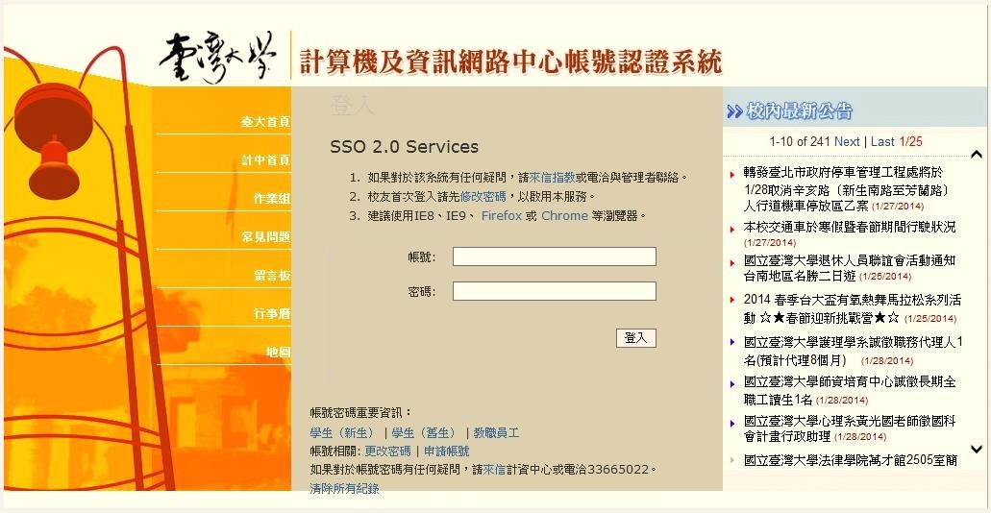
2. 登入頁面, 請使用臺大校內 Single Sign On

Slide 16


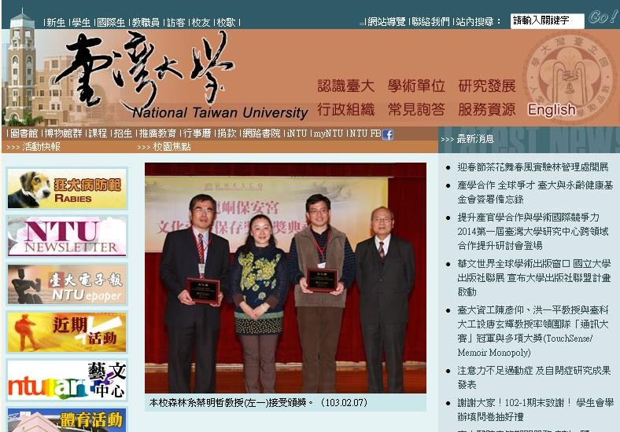
3. 臺大 Single Sign On 登出連結
請登出
點選下方網址, 即可登出並進入臺大首頁
https://adfs.ntu.edu.tw/adfs/ls/clearall.aspx

Slide 17
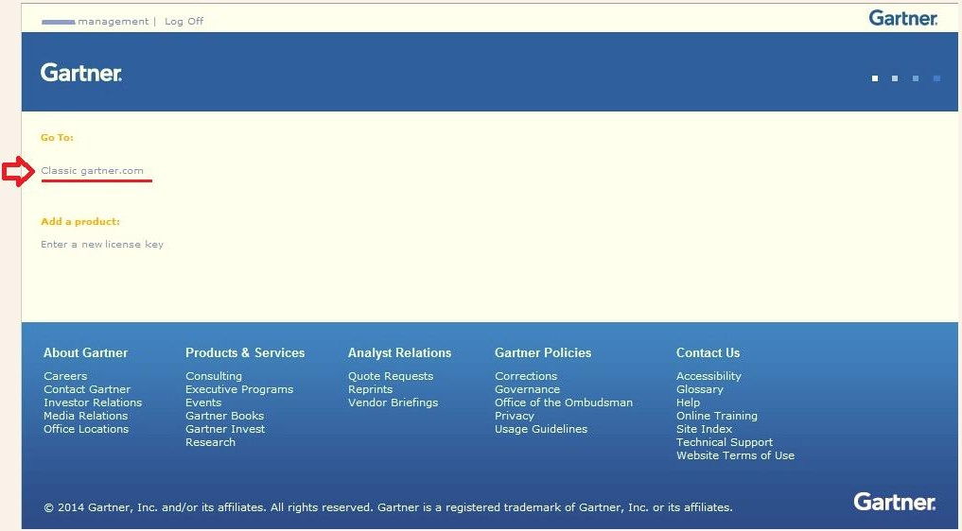
4. 首次登入, 請前往 Classic gartner.com

Slide 18
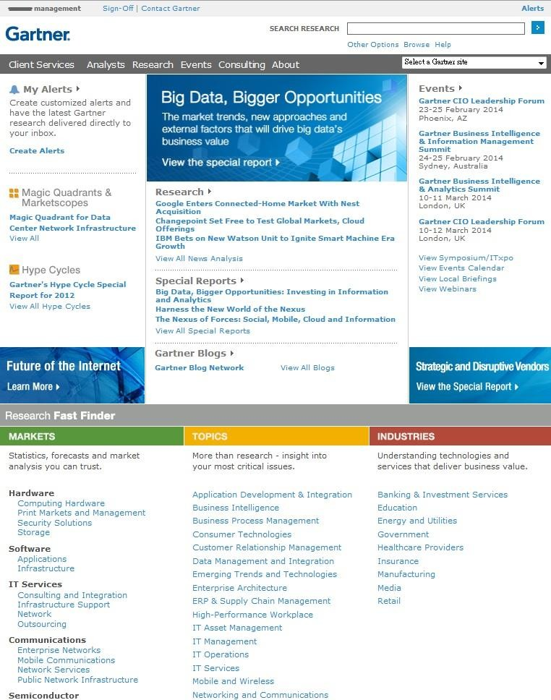
5. Gartner資料庫首頁

Slide 19
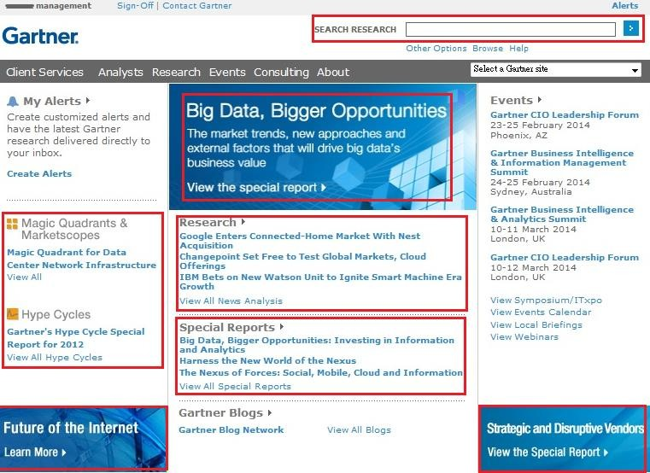
6. 資料搜尋
每個紅框內, 皆有目前最受 矚目的議題與 方法論之連結
最快速的方法: 建議使用”關鍵 字”搜尋 ; 例 :BI, Cloud, Security, AI…

Slide 20



Thank You !

