Slide 1
Cycling around Taiwan make your GMBA Journey special

Slide 2
Why cycling around Taiwan?
You may have been to many cities in Taiwan, but you have never explored this country yet!
9 Days cycling, 900km, Challenge!
If you don't do it now, you will never do it in your whole life!
Having an unforgettable and meaningful experience with your friends to make your GMBA journey special!

Slide 3
The scenery during the trip...

Slide 4
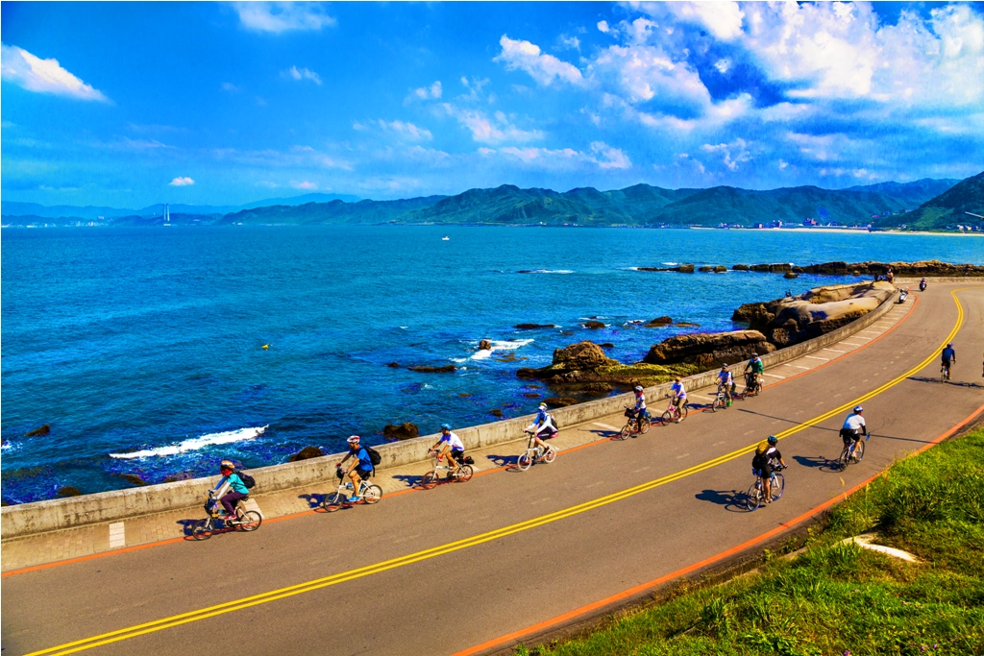
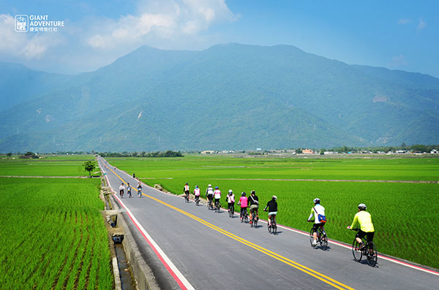
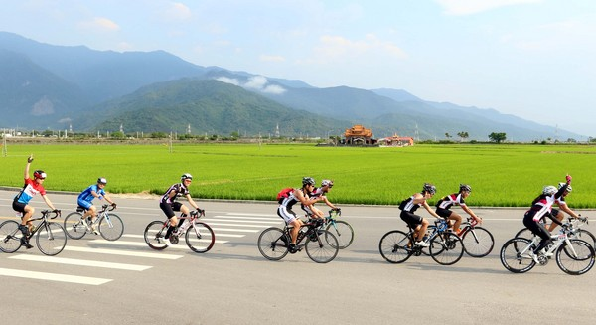
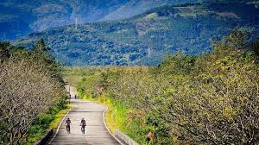
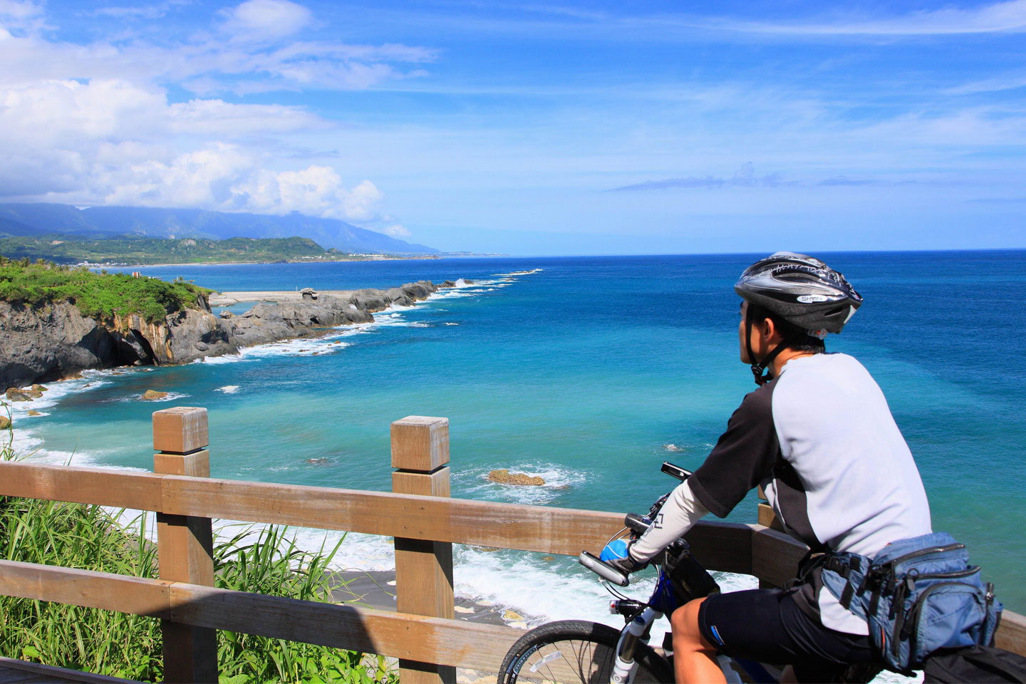
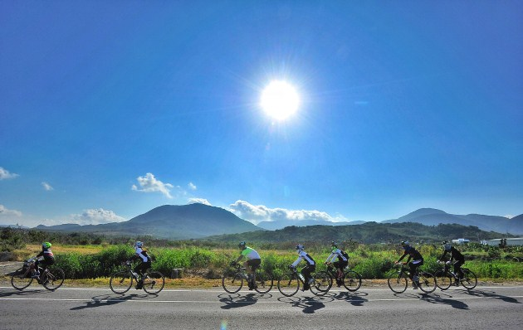

Slide 5
Cycling route
1
Rock your life

Slide 6
Date : Mar 30-April7,2019
Days: 9 days
(only need to ask 3days leave)
April1-5 is NTU spring break, if you are student, you won't miss any class
Distance:910 kms
Departure: Taipei

Slide 7
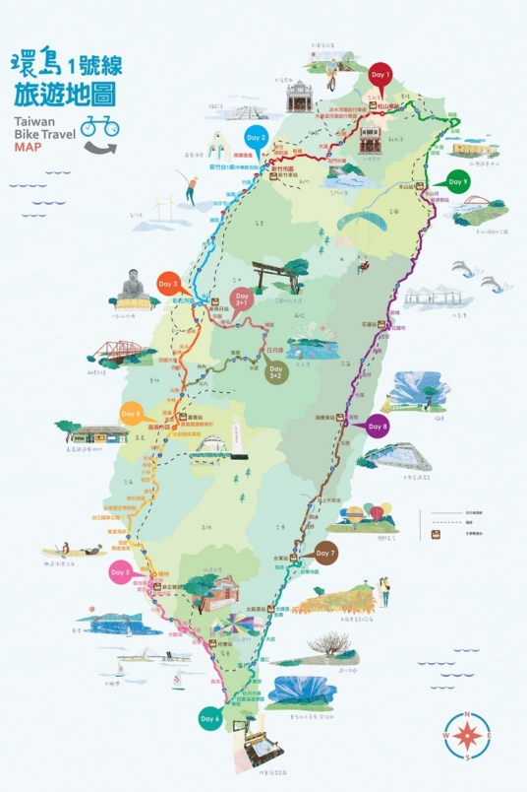
Routes
Taipei
day9:
76km
day1:
90km
day2:
120km
Hsinchu
Jiaoxi
Average daily riding distance:100km
Daily riding hours: 6-8hrs.
Resting point:
1hr per rest point.
Average speed:
20-25km/hr
Lukang
day8:
81km
day3:
83km
Chiayi
Ruisui
day7:
125km
day4:
125km
Zhiben
Kaohsiung
day6:
110km
day5:
100km
Checheng

Slide 8
Logistical support
2
Make the challenge
Safe and Achievable

Slide 9
What do we have?
2 Support Van
Don't have to carry your luggage
1 Leading cycling escort
1 Rear technician escort

Slide 11
Accomodation
3
Comfortable and worthy

Slide 12
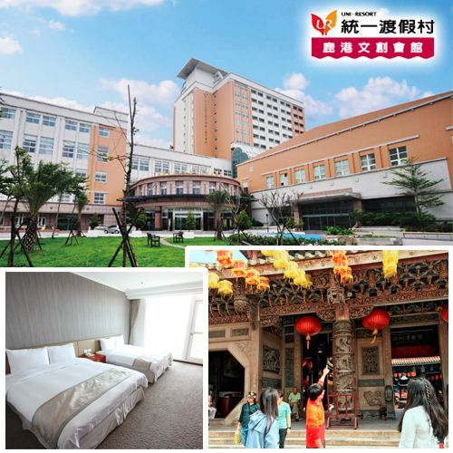
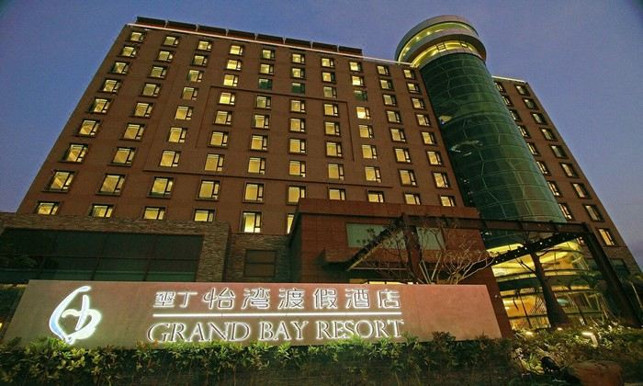
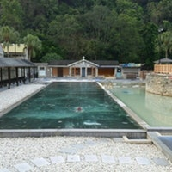
After a long day riding, we stay at 4 star hotel to fully rest but with economic price.
Hotel
quadruple room

Slide 13
Bicycle
4
well-equipped Giant bicyle

Slide 14
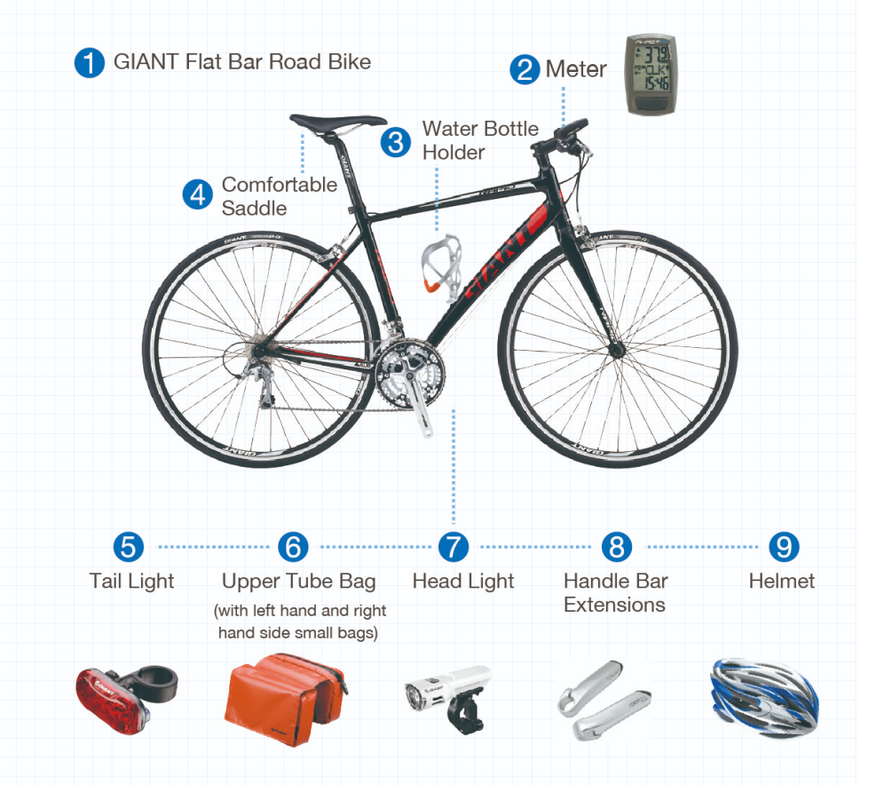
Bike rental
You don't have to prepare
your own bicycle
, we provide well-equipped bicyle
without extra fee.

Slide 15
What can we get after complete challenge?
You will wear unique and comfortable GMBA jersey.
During the trip, your friends can go to Giant travel Agency website to track you and cheer up for you!
You will get a completion certificate to prove you have completed the challenge
Giant travel agency will help us taking photos during the trip and make the video. Memory is the best gift!
A memory and experience for the whole life, you only live once, go adventure!

Slide 16
Price
9days
32000NTD per person
including:
hotel , food, bicycle, support van, leading cycling escort, technician, insurance,1 jersey,supplyment,etc..
All you need is your own cloth!
The price is not cheap but
reasonable and worthy!
An unforgettable and meaningful experience is priceless!
Safety is priority !

Slide 17
Q&A
Q: I don't do exercise frequently, I am not sure whether I can make it?
We will organize some practices 8weeks before, everyone can join freely.
Q: If I feel too tired to contiune riding, what help will I get?
we have 2 support van, if you are physically tired , you can get onboard to rest.

Slide 18
Q&A
Q: The package price is expensive for me..
We are very happy to tell that the price we get from Giant travel agency is special offer only for GMBA. More people join, more discount we can get. We will also try to get installment if it is needed.
Q: I am not sure whether I am available that days..
We are still recruiting people and we won't charge any deposit so far. Even after payment, you can still get refund based on contract. EX.Cancel 45days before departure,only charge 5% payment.

Slide 19
Q&A
Q: If the weather is rainy or encounters typhoon...
We provide rainy coat for everybody, and our professional guide will make dicision depends on weather condition. If encounters typhoon, Giant will ensure our safety and bus transportation.
Q:When is the dealine for sign up this trip?
if you are interested in it, we would like to kindly invite you to our line group for further infos first to help us organize this event.The dealine for sign up and payment might be around middle of Dec. to Early Jan.

Slide 20
SIGN UP AND JOIN US!
If you are interested in this crazy adventure,please contact us for further info
Contact person: Ester Li , laptop12366@gmail.com

